Slide 1




Slide 2
Objectives
Describe implementation activities
Describe various types of software tests and explain how and why each is used
Explain the importance of the configuration and change management discipline to the implementation, testing, and deployment of a system
Object-Oriented Analysis and Design with the Unified Process

Slide 3
Objectives (continued)
List various approaches to data conversion and system deployment and describe the advantages and disadvantages of each
Describe training and user support requirements for new and operational systems
Object-Oriented Analysis and Design with the Unified Process

Slide 4
Overview
Activities from additional UP disciplines are needed to bring a system into being
  Implementation
  Testing
  Deployment
  Configuration and change management
Describe each activity in isolation and then discuss the interrelationships among the disciplines
Object-Oriented Analysis and Design with the Unified Process

Slide 5
Implementation
Implementation activities are concerned with software components
  Software modules that are fully assembled, ready to use, and have well-defined interfaces
Choose a component interaction standard to describe how components interact
  CORBA, J2EE, COM, SOAP
Implement classes, package them into executable units, and install application software
Object-Oriented Analysis and Design with the Unified Process

Slide 6
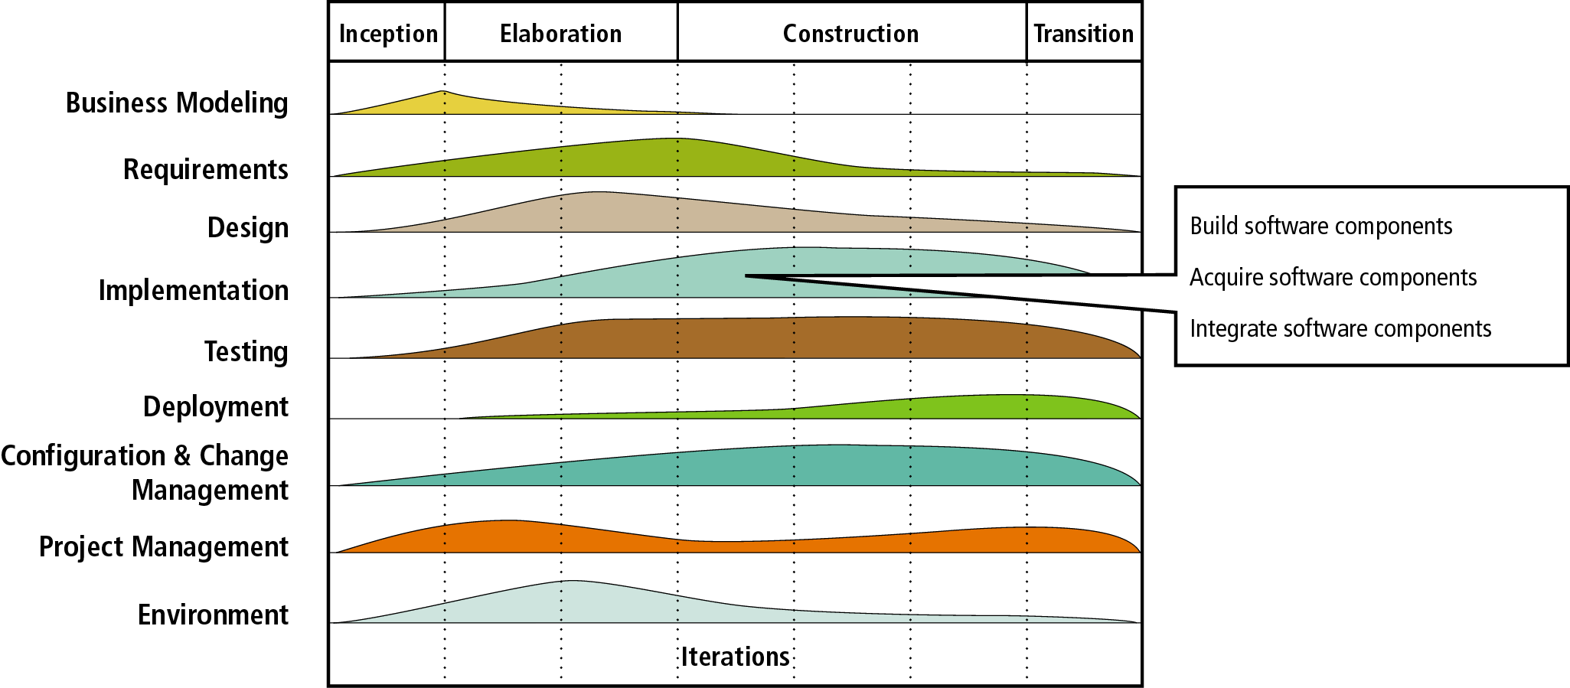
Figure 13-1
Implementation discipline activities
Object-Oriented Analysis and Design with the Unified Process

Slide 7
Testing
Testing is a process of identifying defects
Develop test cases and test data
  A test case is a formal description of
    A starting state
    One or more events to which the software must respond
    The expected response or ending state
  Test data is a set of starting states and events used to test a module, group of modules, or entire system
Object-Oriented Analysis and Design with the Unified Process

Slide 8
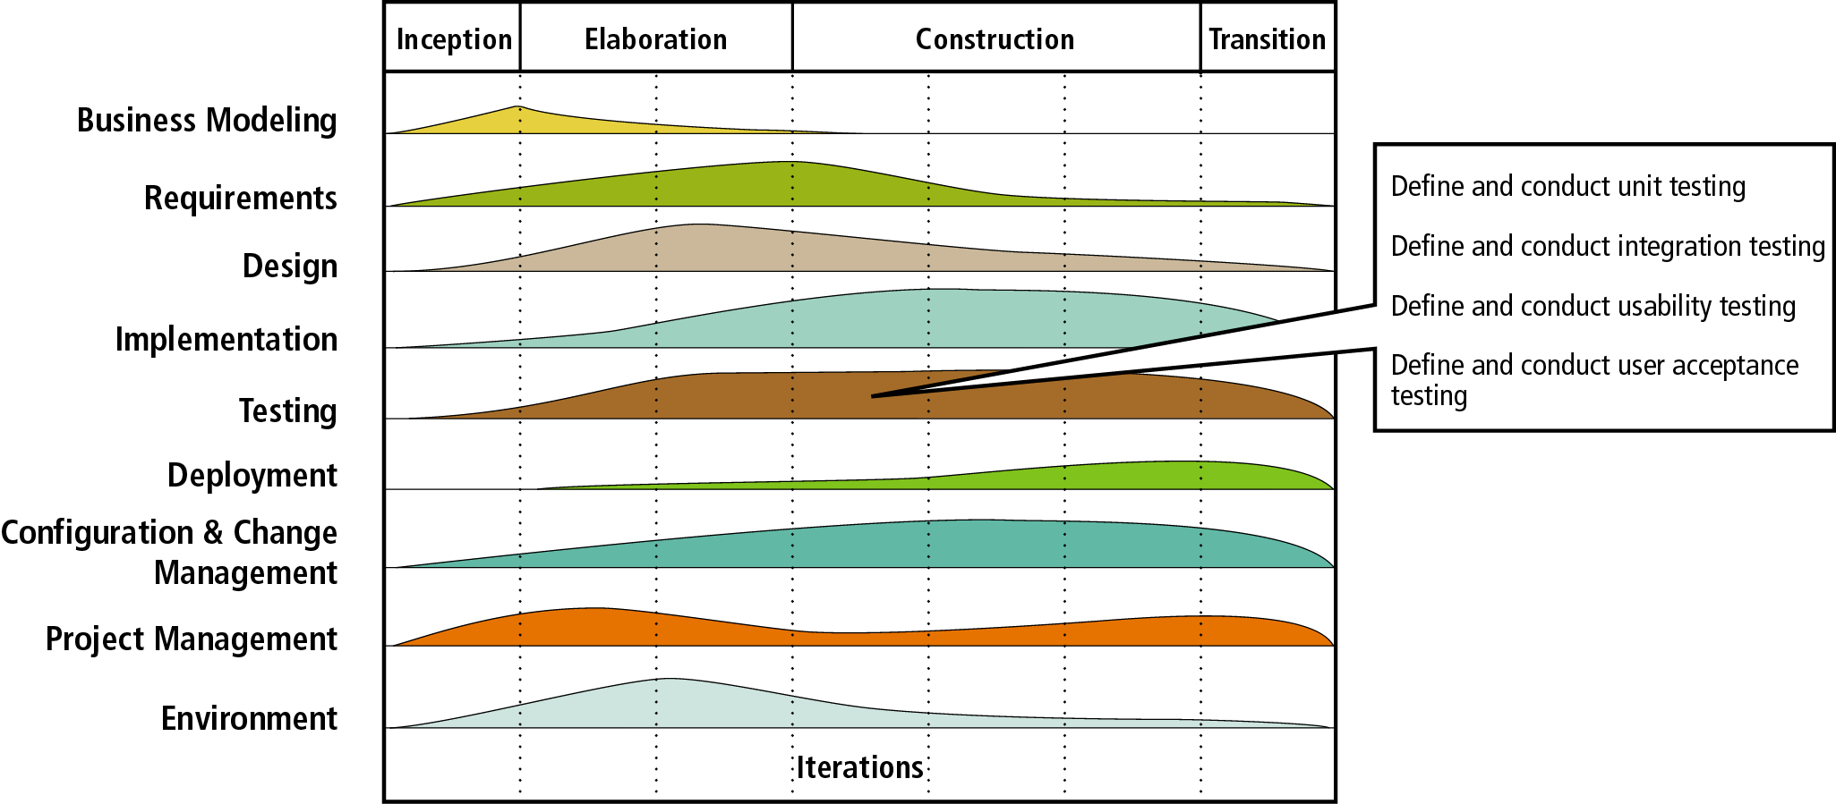
Figure 13-2
Testing discipline activities
Object-Oriented Analysis and Design with the Unified Process

Slide 9
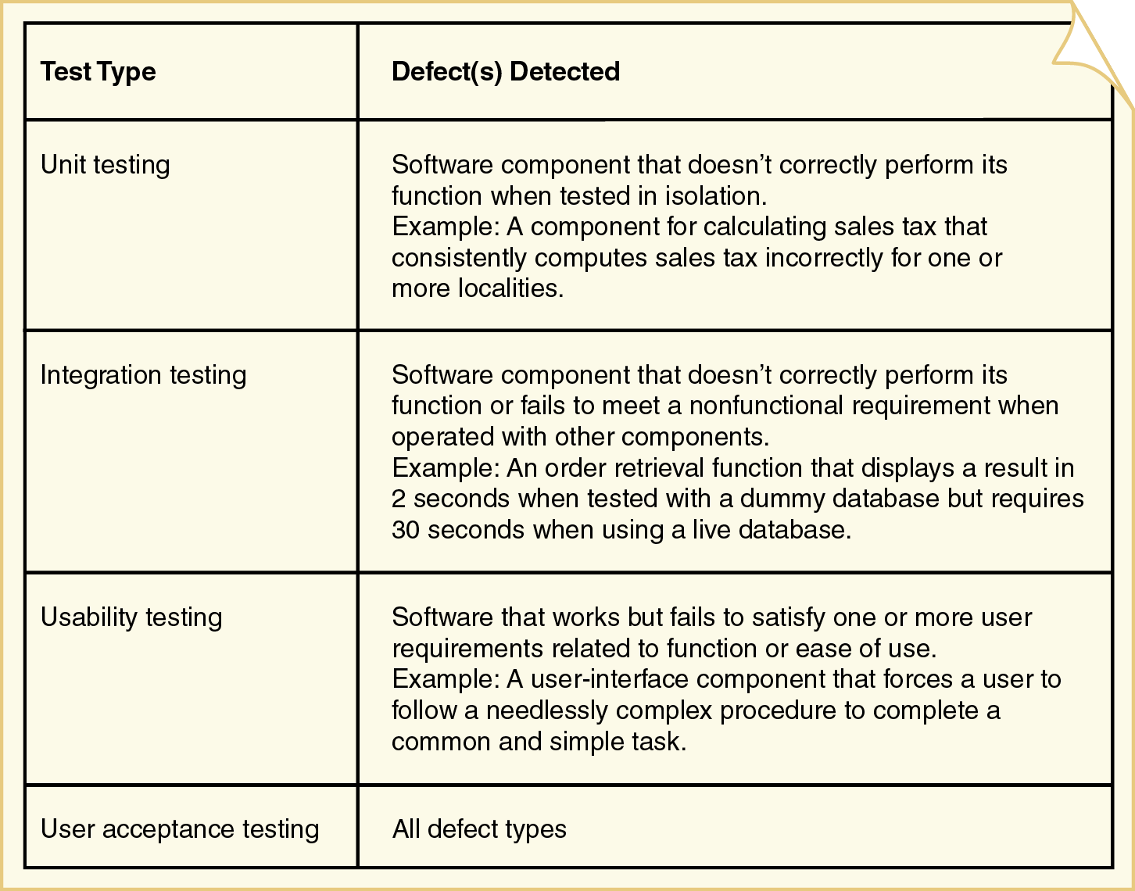
Figure 13-3: Test types and detected defects
Object-Oriented Analysis and Design with the Unified Process

Slide 10
Unit Testing
The process of testing individual methods, classes, or components before they are integrated with other software
Two methods for isolated testing of units
  Driver
    Simulates the behavior of a method that sends a message to the method being tested
  Stub
    Simulates the behavior of a method that has not yet been written
Object-Oriented Analysis and Design with the Unified Process

Slide 11
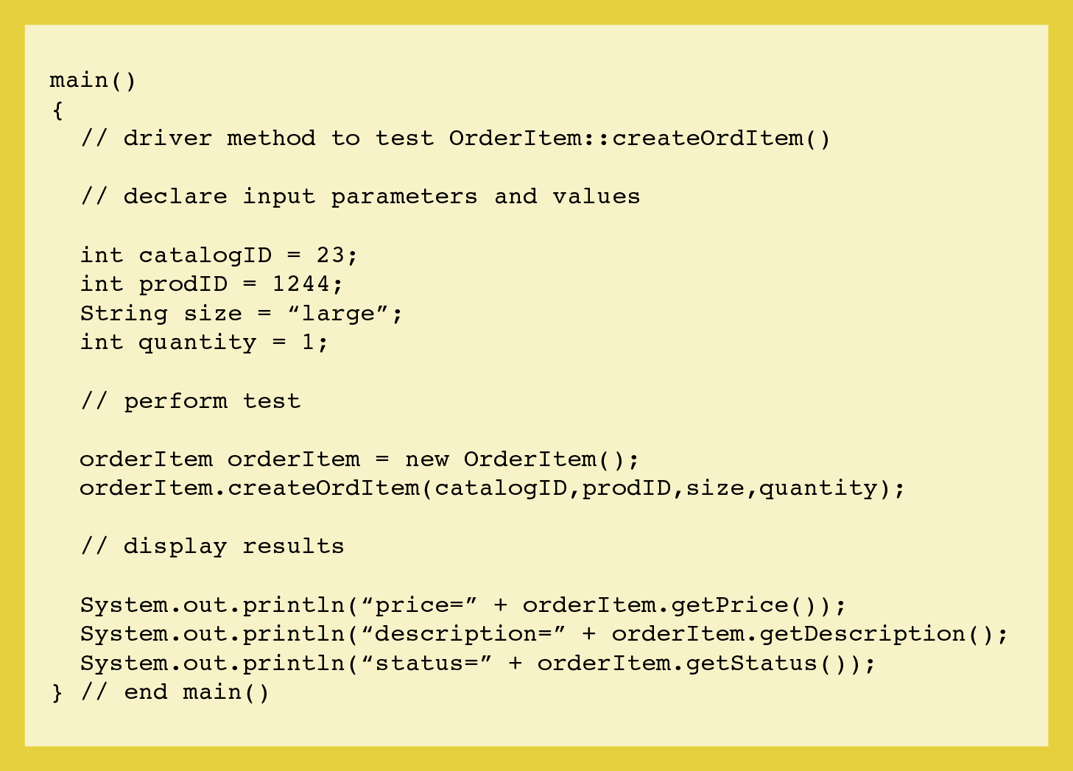
Figure 13-5: A driver module to test createOrdItem()
Object-Oriented Analysis and Design with the Unified Process

Slide 12
Figure 13-5: A driver module to test createOrdItem()
Object-Oriented Analysis and Design with the Unified Process

Slide 13
Integration Testing
Evaluates the behavior of a group of methods or classes
  Identifies interface compatibility, unexpected parameter values or state interaction, and run-time exceptions
System test
  Integration test of the behavior of an entire system or independent subsystem
Build and smoke test
  System test performed daily or several times a week
Object-Oriented Analysis and Design with the Unified Process

Slide 14
Usability Testing
Determines whether a method, class, subsystem, or system meets user requirements
Performance test
  Determines whether a system or subsystem can meet time-based performance criteria
    Response time specifies the desired or maximum allowable time limit for software responses to queries and updates
    Throughput specifies the desired or minimum number of queries and transactions that must be processed per minute or hour
Object-Oriented Analysis and Design with the Unified Process

Slide 15
User Acceptance Testing
Determines whether the system fulfills user requirements
  Involves the end users
Acceptance testing is a very formal activity in most development projects
Object-Oriented Analysis and Design with the Unified Process

Slide 16
Who Tests Software?
Programmers
  Unit testing
  Testing buddies can test other’s programmer’s code
Users
  Usability and acceptance testing
  Volunteers are frequently used to test beta versions
Quality assurance personnel
  All testing types except unit and acceptance
  Develop test plans and identify needed changes
Object-Oriented Analysis and Design with the Unified Process

Slide 17
Configuration and Change Management
Controls the complexity associated with testing and supporting a system through multiple development and operational versions
Integrally related to project management, implementation, testing, and deployment activities
Change control procedures are typically developed in the first iteration before development
Need for formal procedures depends on size and cohesiveness of project
Object-Oriented Analysis and Design with the Unified Process

Slide 18
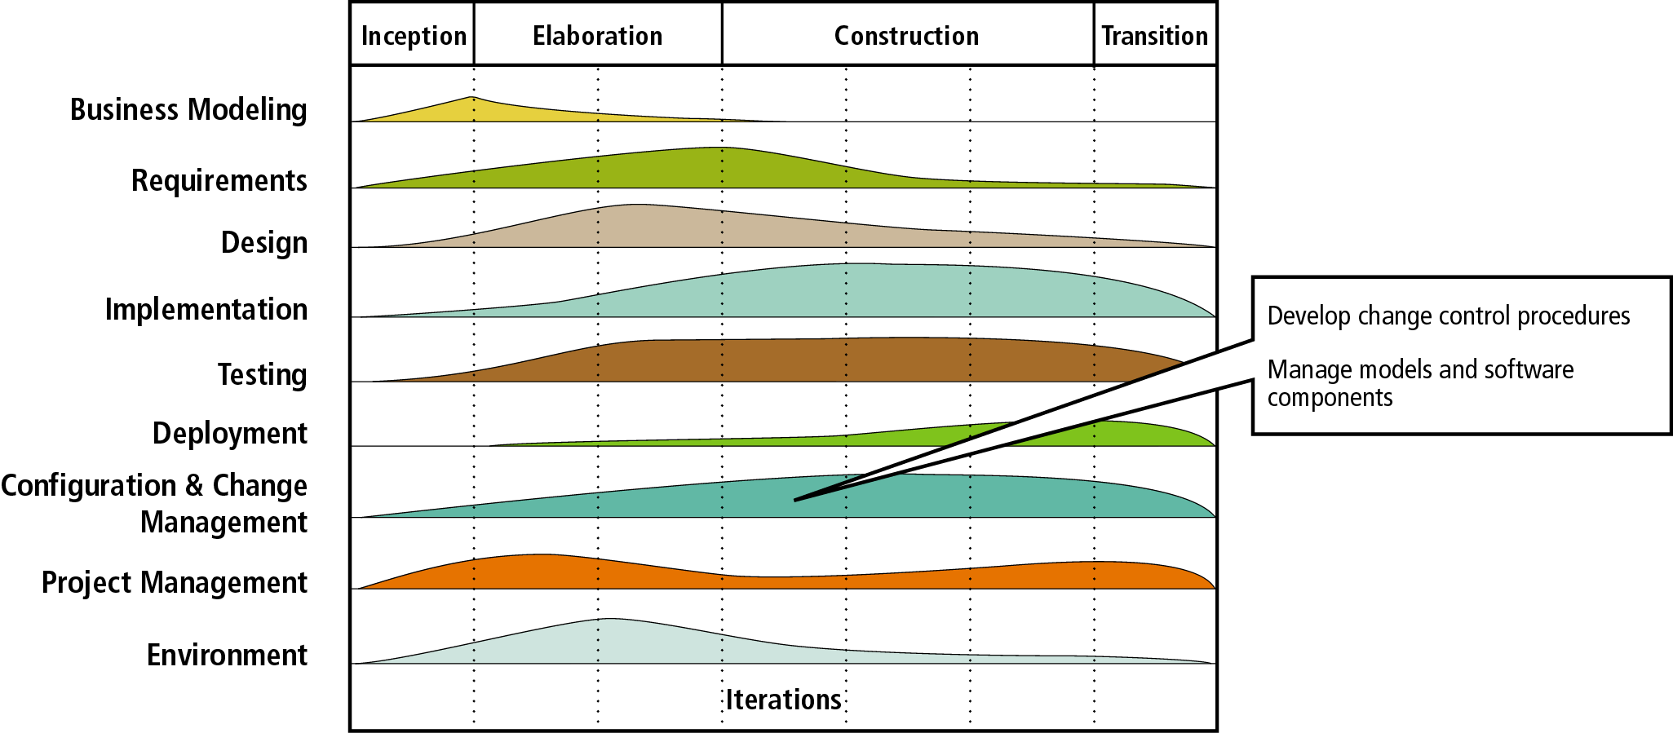
Figure 13-7
Configuration and change management discipline activities
Object-Oriented Analysis and Design with the Unified Process

Slide 19
Versioning
Alpha version
  Test version that is incomplete but ready for some level of rigorous integration or usability testing
Beta
  Test version that is stable enough to be tested by end users for an extended period of time
Production version
  System version that is formally distributed to users or made operational for long-term use
Maintenance release
  System update that provides bug fixes and small changes to existing features
Object-Oriented Analysis and Design with the Unified Process

Slide 20
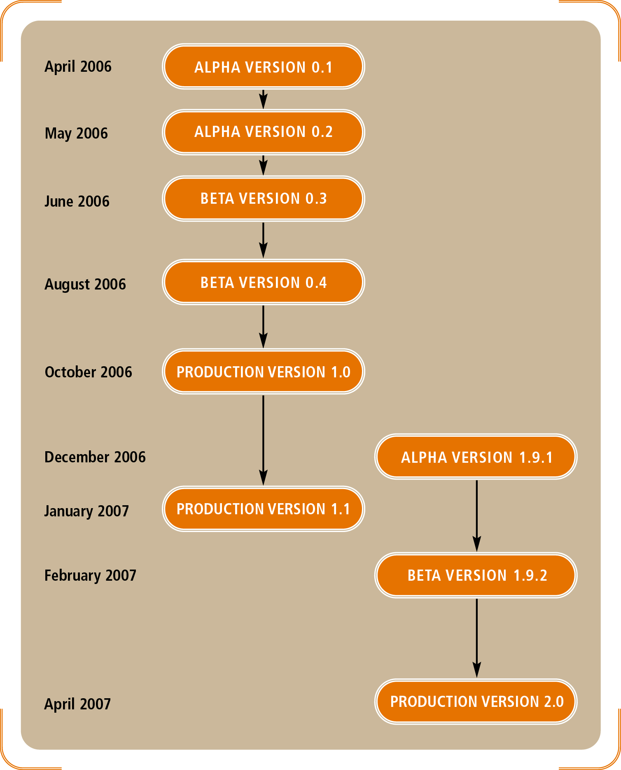
Figure 13-8: A time line of test and production versions for the RMO customer support system (CSS)
Object-Oriented Analysis and Design with the Unified Process

Slide 21
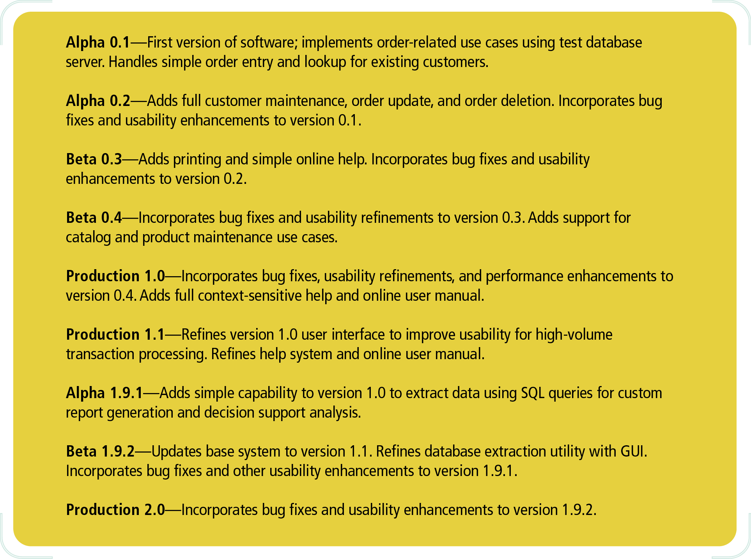
Figure 13-9
Description of RMO CSS versions
Object-Oriented Analysis and Design with the Unified Process

Slide 22
Submitting Change Requests and Error Reports
Typical change control procedures include
  Standard change request forms
    Completed by a user or system owner
  Review of requests by a change control committee
    Assess impact on system, security, and budget
  Extensive planning for design and implementation
Bugs reports are often reported separately because of the need for an immediate fix
Object-Oriented Analysis and Design with the Unified Process

Slide 23
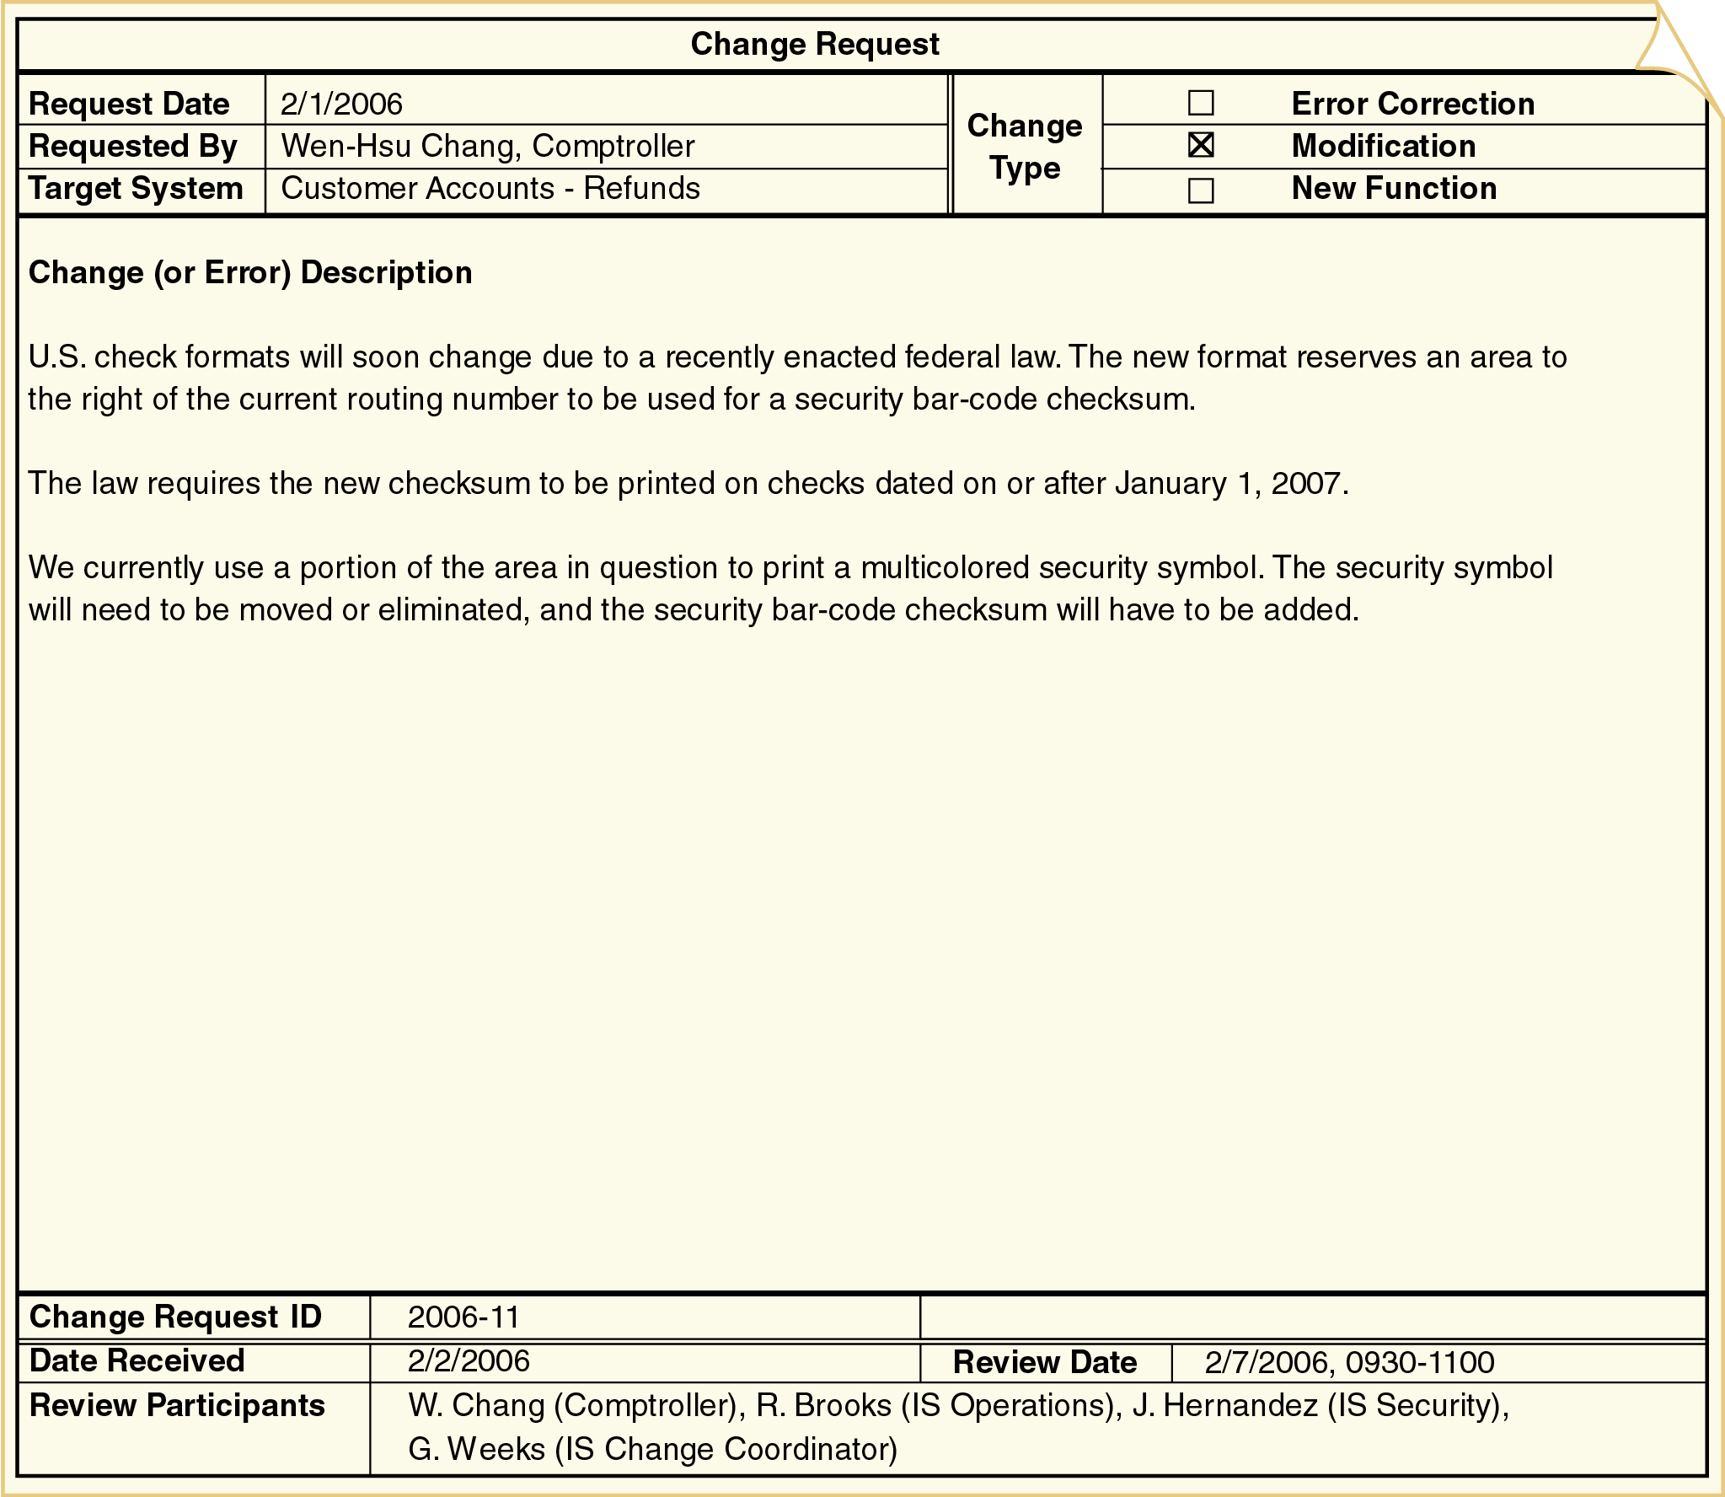
Figure 13-11: A sample change request form
Object-Oriented Analysis and Design with the Unified Process

Slide 24
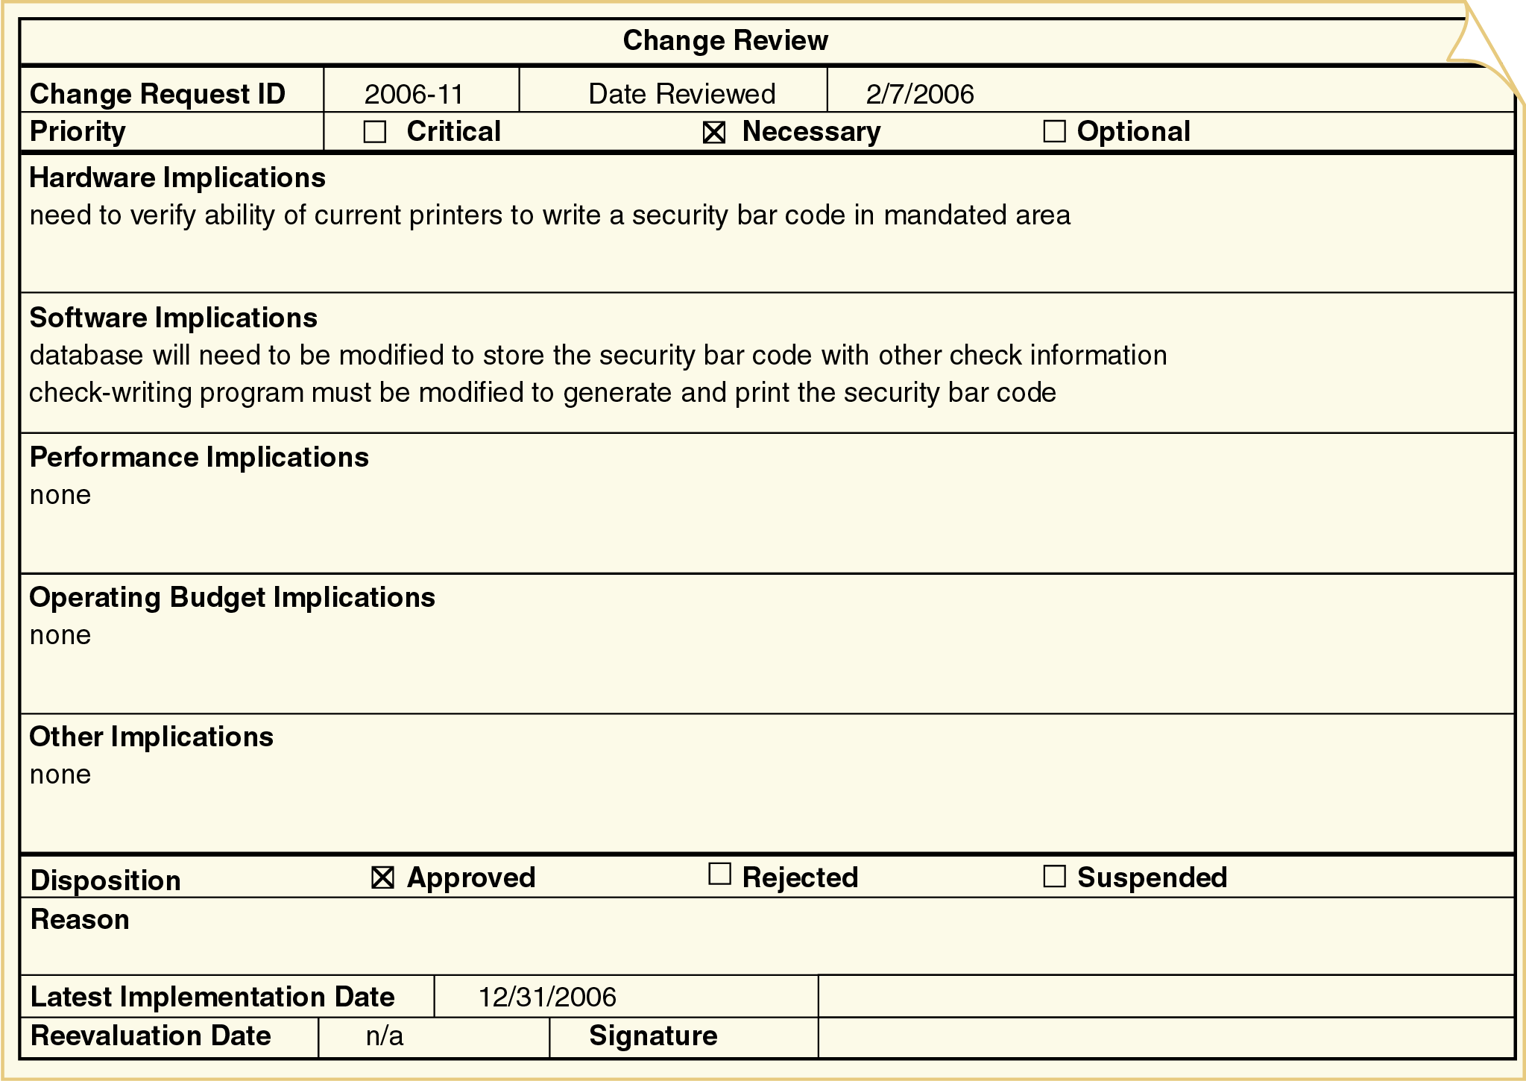
Figure 13-12: A sample change review form
Object-Oriented Analysis and Design with the Unified Process

Slide 25
Implementing a Change
Change implementation follows a miniature version of the UP life cycle
  One or two iterations with reduced business modeling, requirements, and design activities
When possible, changes are implemented on a copy of the production system
  The production system is the version of the system used from day to day
  The test version is a copy of the production system that is modified to test changes
Object-Oriented Analysis and Design with the Unified Process

Slide 26
Upgrading Computing Infrastructure
Computer hardware, system software, and networks must be periodically upgraded due to
  Software maintenance releases
  Software version upgrades
  Declining system performance
Best practice for upgrades
  If an operational system isn’t broken, don’t fix it!
Performance upgrades require research, careful diagnosis, and technical expertise
Object-Oriented Analysis and Design with the Unified Process

Slide 27
Deployment
Activities to make a new system operational
Involve many conflicting constraints
  Costs
  Need to maintain positive customer relations
  Need to support employees
  Logistical complexity
  Overall risk to the organization
Object-Oriented Analysis and Design with the Unified Process

Slide 28
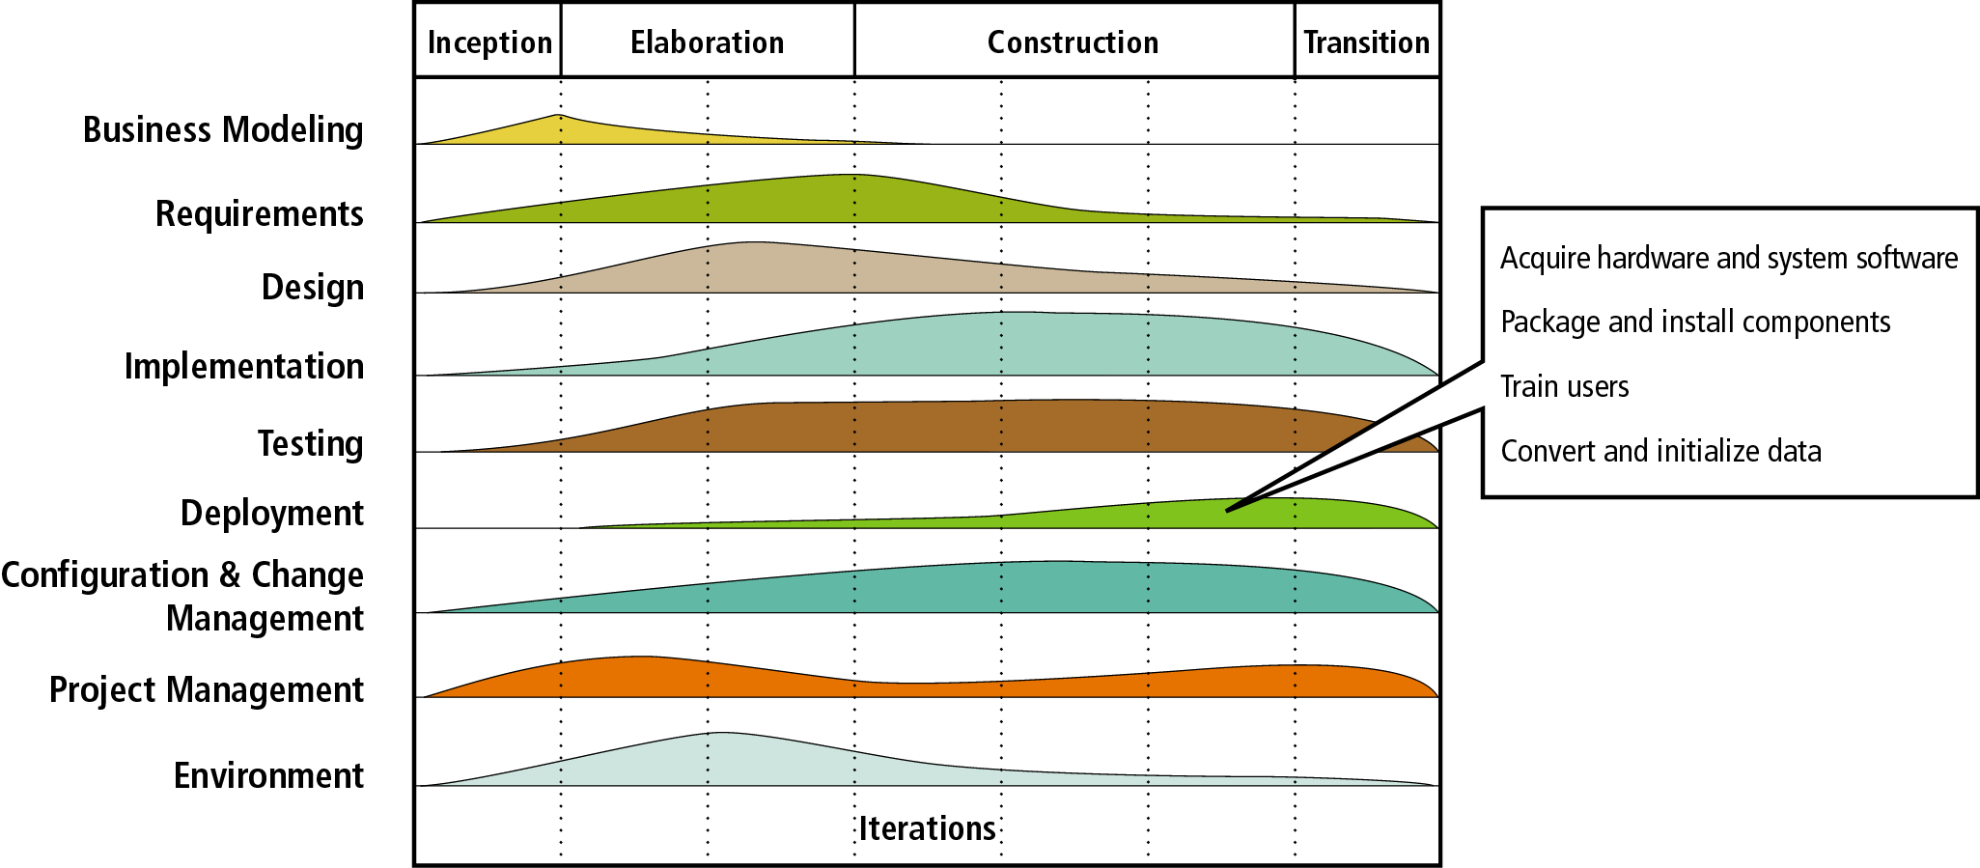
Figure 13-13
Deployment discipline activities
Object-Oriented Analysis and Design with the Unified Process

Slide 29
Acquiring Hardware and System Hardware
Application software must have a supporting infrastructure (which may already be in place)
Acquisition of an entirely new infrastructure includes
  Planning
  Developing a request for proposal
  Evaluating results
  Choosing one or more vendors
  Installation and configuration
Object-Oriented Analysis and Design with the Unified Process

Slide 30
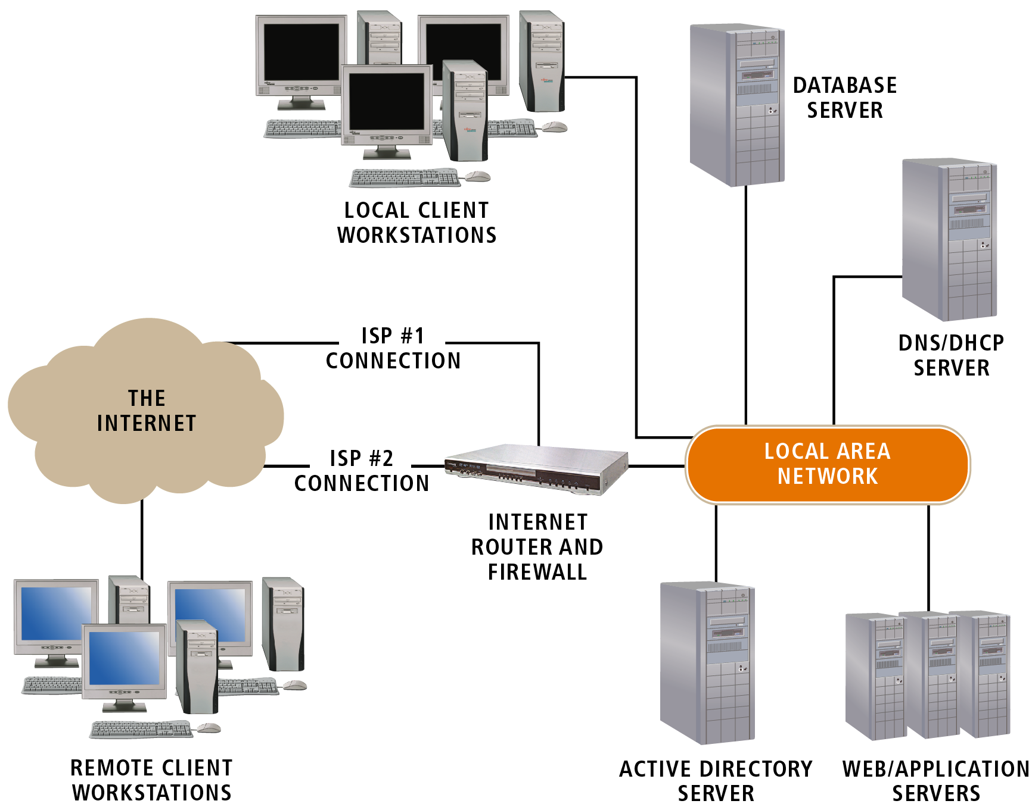
Figure 13-14
Infrastructure and clients of a typical .NET application
Object-Oriented Analysis and Design with the Unified Process

Slide 31
Packaging and Installing Components
Components must be
  Installed on a host server
  Added to a component registry
  Assigned one or more network addresses
May include XML files to store registration and access information
Developers can package and install components using development tools and utilities
Object-Oriented Analysis and Design with the Unified Process

Slide 32
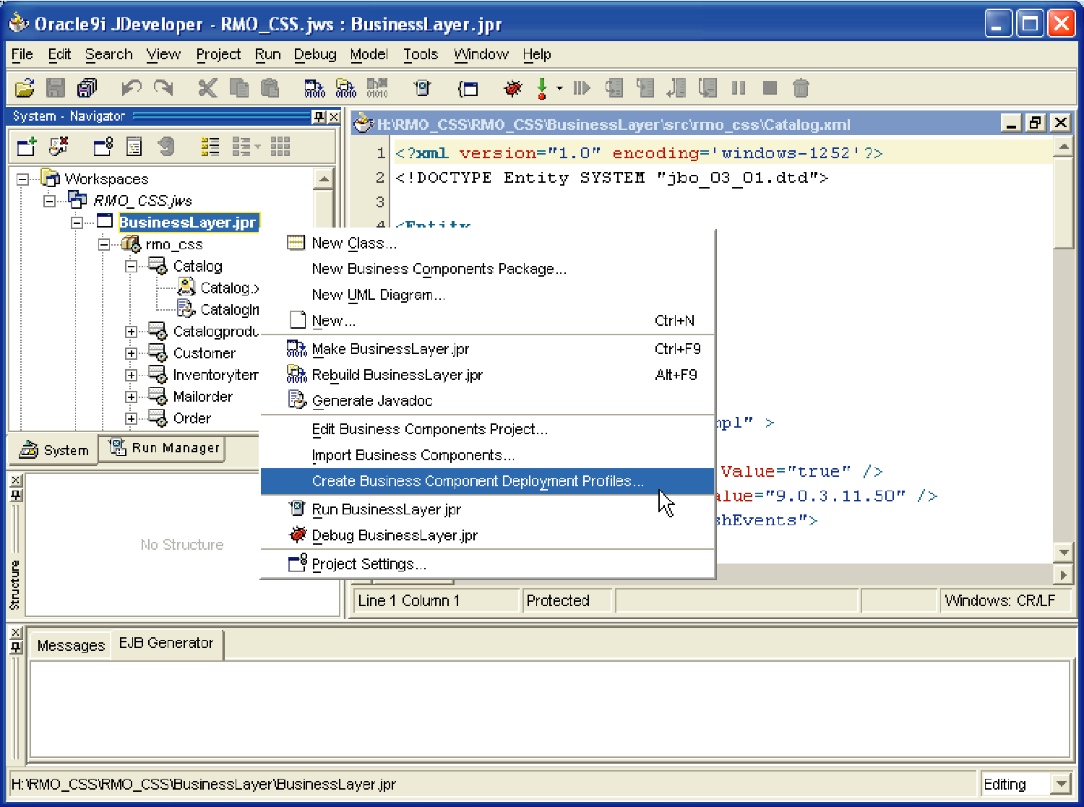
Figure 13-15
Automated component deployment with Oracle Developer
Object-Oriented Analysis and Design with the Unified Process

Slide 33
Training Users
End users and system operators need training
End user training
  Hands-on training and tutorials
  Group tutorials
System operator training
  Less formal
  Self-study
Training materials are developed as soon as the interfaces are reasonably stable
Object-Oriented Analysis and Design with the Unified Process

Slide 34
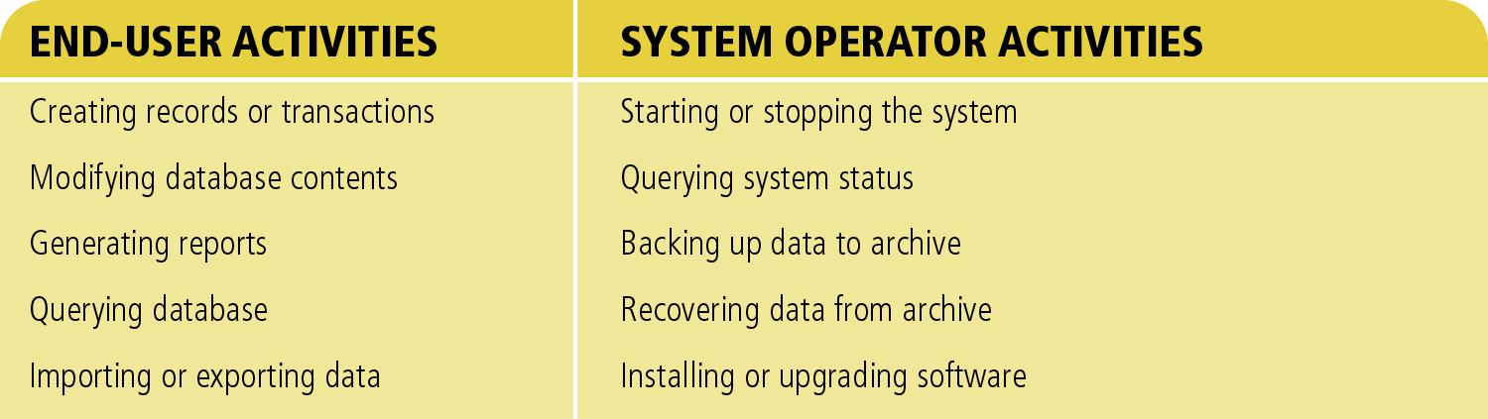
Figure 13-16
Typical activities of end users and system operators
Object-Oriented Analysis and Design with the Unified Process

Slide 35
Converting and Initializing Data
Data needed at system startup can be obtained from
  Files or databases of a system being replaced
  Manual records
  Files or databases of other systems in the organizations
  User feedback during normal system operation
Existing databases are commonly modified for reuse in new or upgraded systems
Object-Oriented Analysis and Design with the Unified Process

Slide 36
Reloading Databases
Complex changes to a database may require reloading the data after the change
Two approaches
  Initialize a new database and copy the contents of the old database to it
  Use a program or DBMS utility to extract and delete data from an existing database and store it in a temporary data store
    Many DBMSs provide import/export utilities to extract and load data
Object-Oriented Analysis and Design with the Unified Process

Slide 37
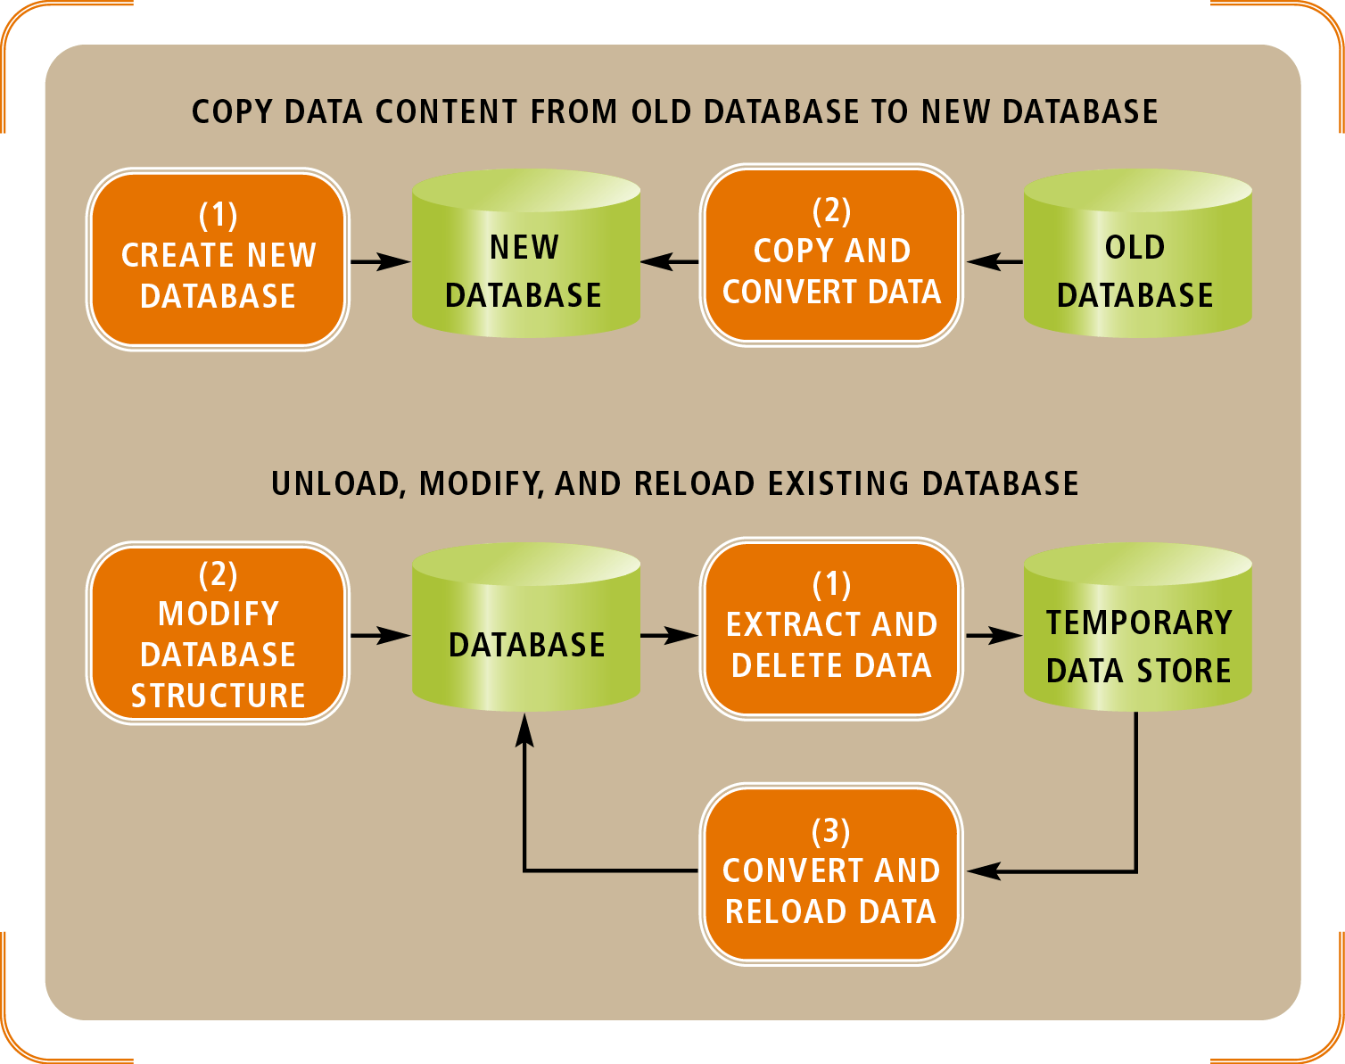
Figure 13-17
Two approaches to reloading database content
after a structural modification
Object-Oriented Analysis and Design with the Unified Process

Slide 38
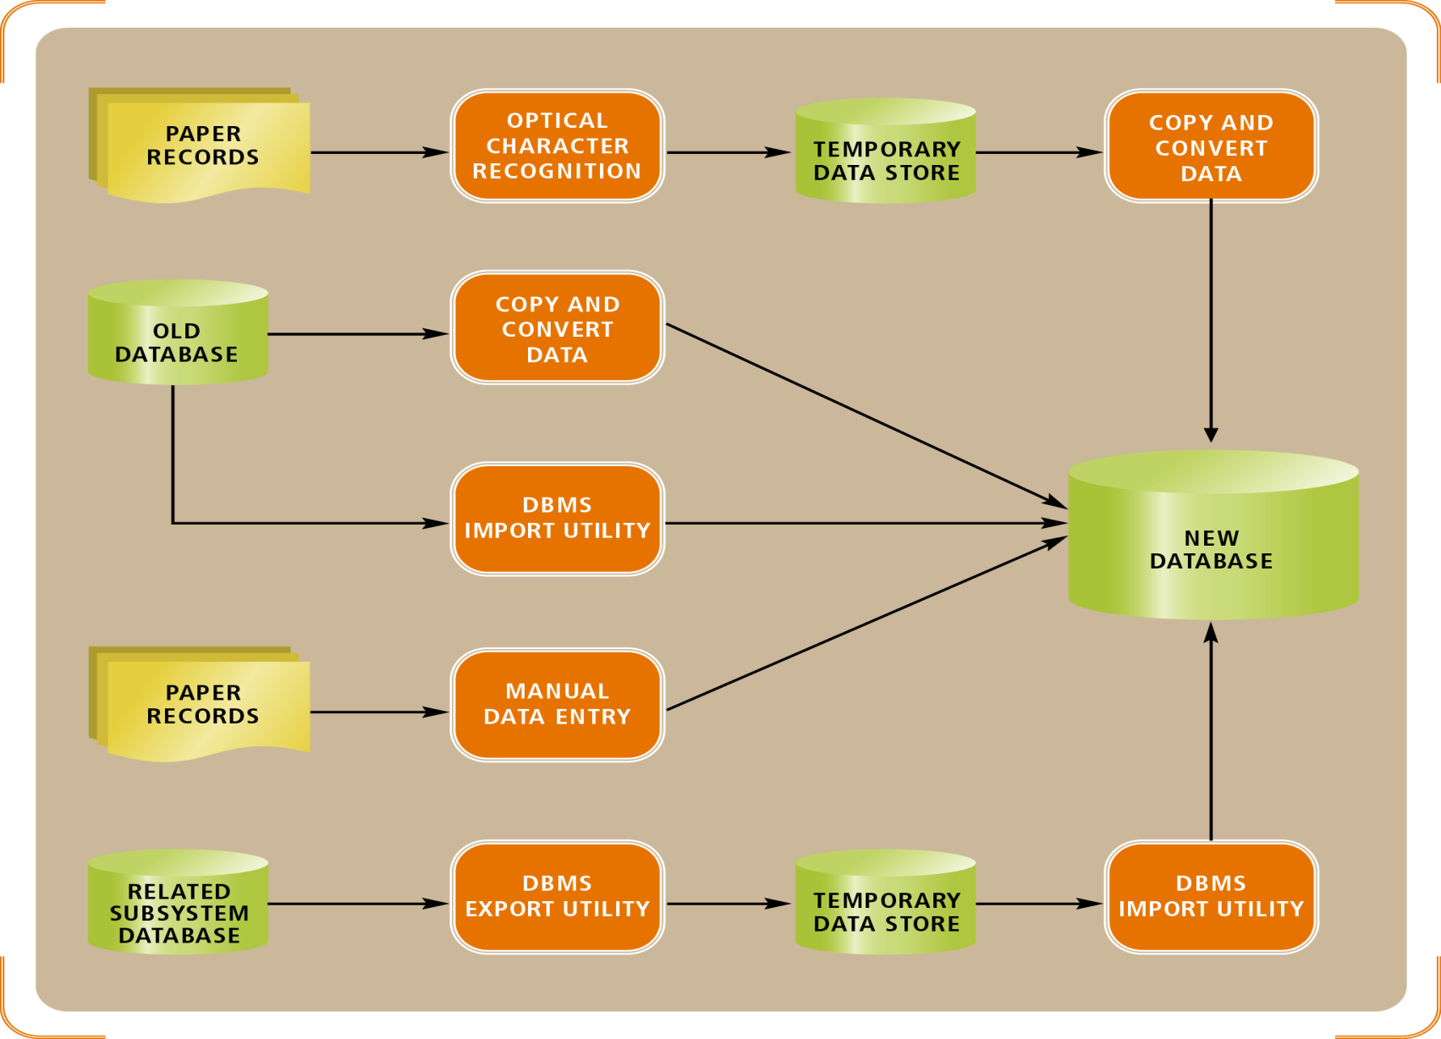
Figure 13-18
A complex data-conversion example
Object-Oriented Analysis and Design with the Unified Process

Slide 39
Planning and Managing Testing
Testing activities must be distributed throughout the project
  Unit and integration testing occur whenever software is developed, acquired, or combined with other software
  Usability testing occurs whenever requirements or design decisions need to be evaluated
  User acceptance tests are conducted as a final validation of the requirements, design, and implementation activities
Object-Oriented Analysis and Design with the Unified Process

Slide 40
Development Order
Input, process, output (IPO) development
  Implements input modules first, process modules next, and output modules last
  Important user interfaces are developed early
Top-down
  Implements top-level modules first
  There is always a working version of the program
Bottom-up
  Implements low-level detailed modules first
  Programmers can be put to work immediately
Object-Oriented Analysis and Design with the Unified Process

Slide 41
Framework Development
Foundation classes
  Object framework that covers most or all of the domain and data access layer classes
  Reused in many parts of the systems and across applications
Whenever possible, developers choose use cases for early iterations that rely on many foundation classes
  Testing early finds bugs before dependent code is developed
Object-Oriented Analysis and Design with the Unified Process

Slide 42
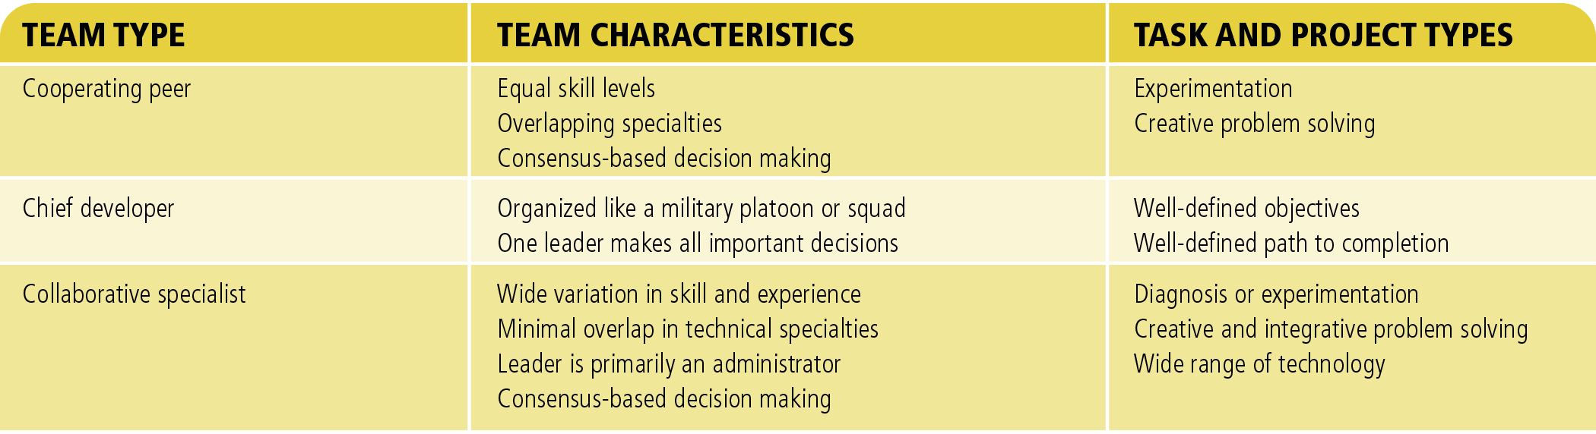
Figure 13-21
A comparison and summary of development team types
Object-Oriented Analysis and Design with the Unified Process

Slide 43
Source Code Control System (SCCS)
Automated tool for tracking source code files and controlling changes to those files
  Stores files in a repository
  Prevents inconsistent change and automates coordination
Programmers can manipulate files in three modes
  Check out a file in read-only mode
  Check out a file in read/write mode
  Check in a modified file
Object-Oriented Analysis and Design with the Unified Process

Slide 44
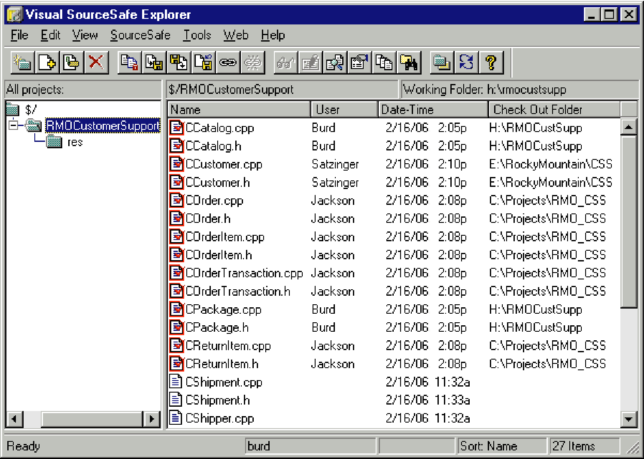
Figure 13-22
Project files managed by a source code control system
Object-Oriented Analysis and Design with the Unified Process

Slide 45
Deployment
Considerations when planning deployment
  Incurring costs of operating both systems in parallel
  Detecting and correcting errors in the new system
  Potentially disrupting the company and its IS operations
  Training personnel and familiarizing customers with new procedures
Each deployment approach has strengths and weaknesses
Object-Oriented Analysis and Design with the Unified Process

Slide 46
Direct Deployment
Installs a new system, quickly makes it operational, and immediately turns off any overlapping systems
Advantages
  Simplicity
Disadvantages
  Risk of system unavailability
Used when a new system is not replacing an old system and/or downtime can be tolerated
Object-Oriented Analysis and Design with the Unified Process

Slide 47
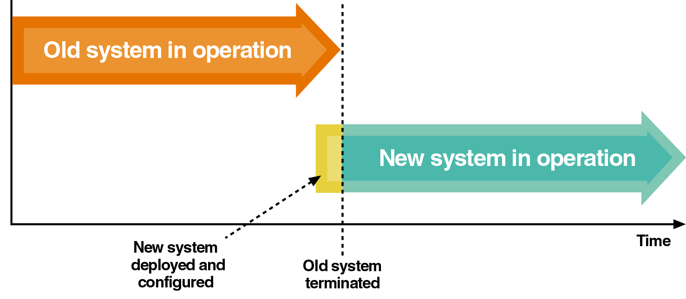
Figure 13-23
Direct deployment and cutover
Object-Oriented Analysis and Design with the Unified Process

Slide 48
Parallel Deployment
Operates both old and new systems for an extended time period
Advantages
  Relatively low risk of system failure
Disadvantage
  Cost to operate both systems
Used for mission-critical applications
Partial parallel deployment can be implemented with increased risk of undetected errors
Object-Oriented Analysis and Design with the Unified Process

Slide 49
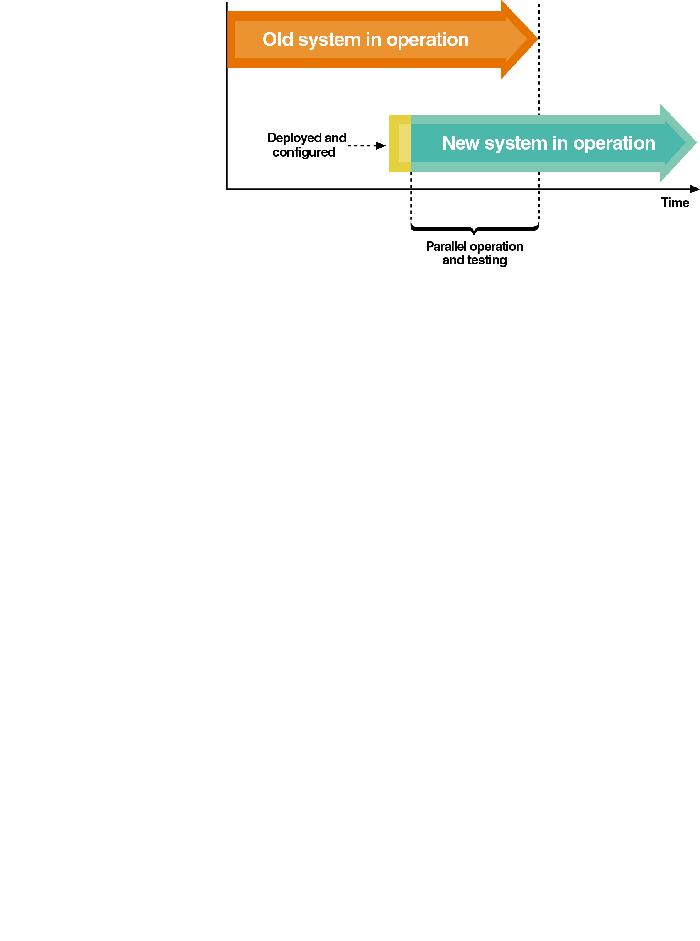
Figure 13-24
Parallel deployment and operation
Object-Oriented Analysis and Design with the Unified Process

Slide 50
Phased Deployment
Installs a new system and makes it operational in a series of steps or phases
Advantages
  Reduced risk
Disadvantages
  Increased complexity
Useful when a system is large, complex, and composed of relatively independent subsystems
Object-Oriented Analysis and Design with the Unified Process

Slide 51
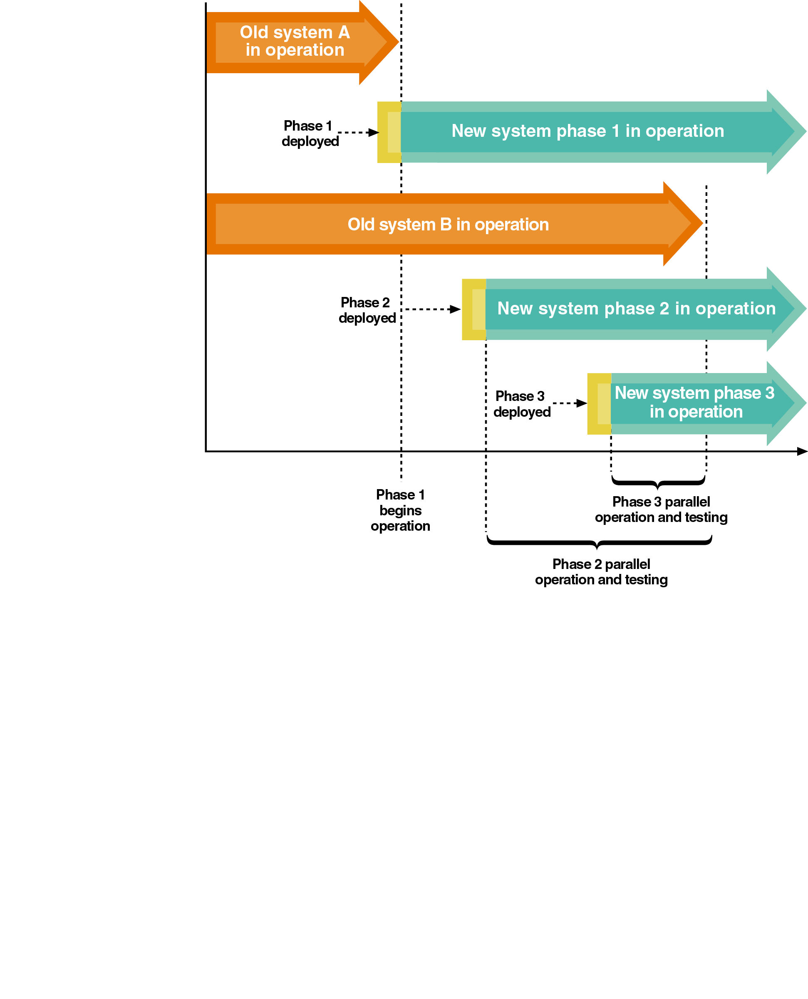
Figure 13-25
Phased deployment with direct cutover and parallel operation
Object-Oriented Analysis and Design with the Unified Process

Slide 52
Personnel Issues
New system deployment places significant demands on personnel
Temporary and contract personnel may be hired to increase manpower, especially during a parallel deployment
  System operators
  Personnel with experience in hardware or software deployment and configuration
Employee productivity decreases temporarily with a new system due to the learning curve
Object-Oriented Analysis and Design with the Unified Process

Slide 53
RMO Revisited
Deal with highest risks in early iterations
  Acquire new infrastructure
  Develop use cases involving Web-based interfaces
Test high-risk elements early
Use phased deployment with the highest risk portion of the system deployed first (in parallel)
Spread training activities throughout later iterations
Object-Oriented Analysis and Design with the Unified Process

Slide 54
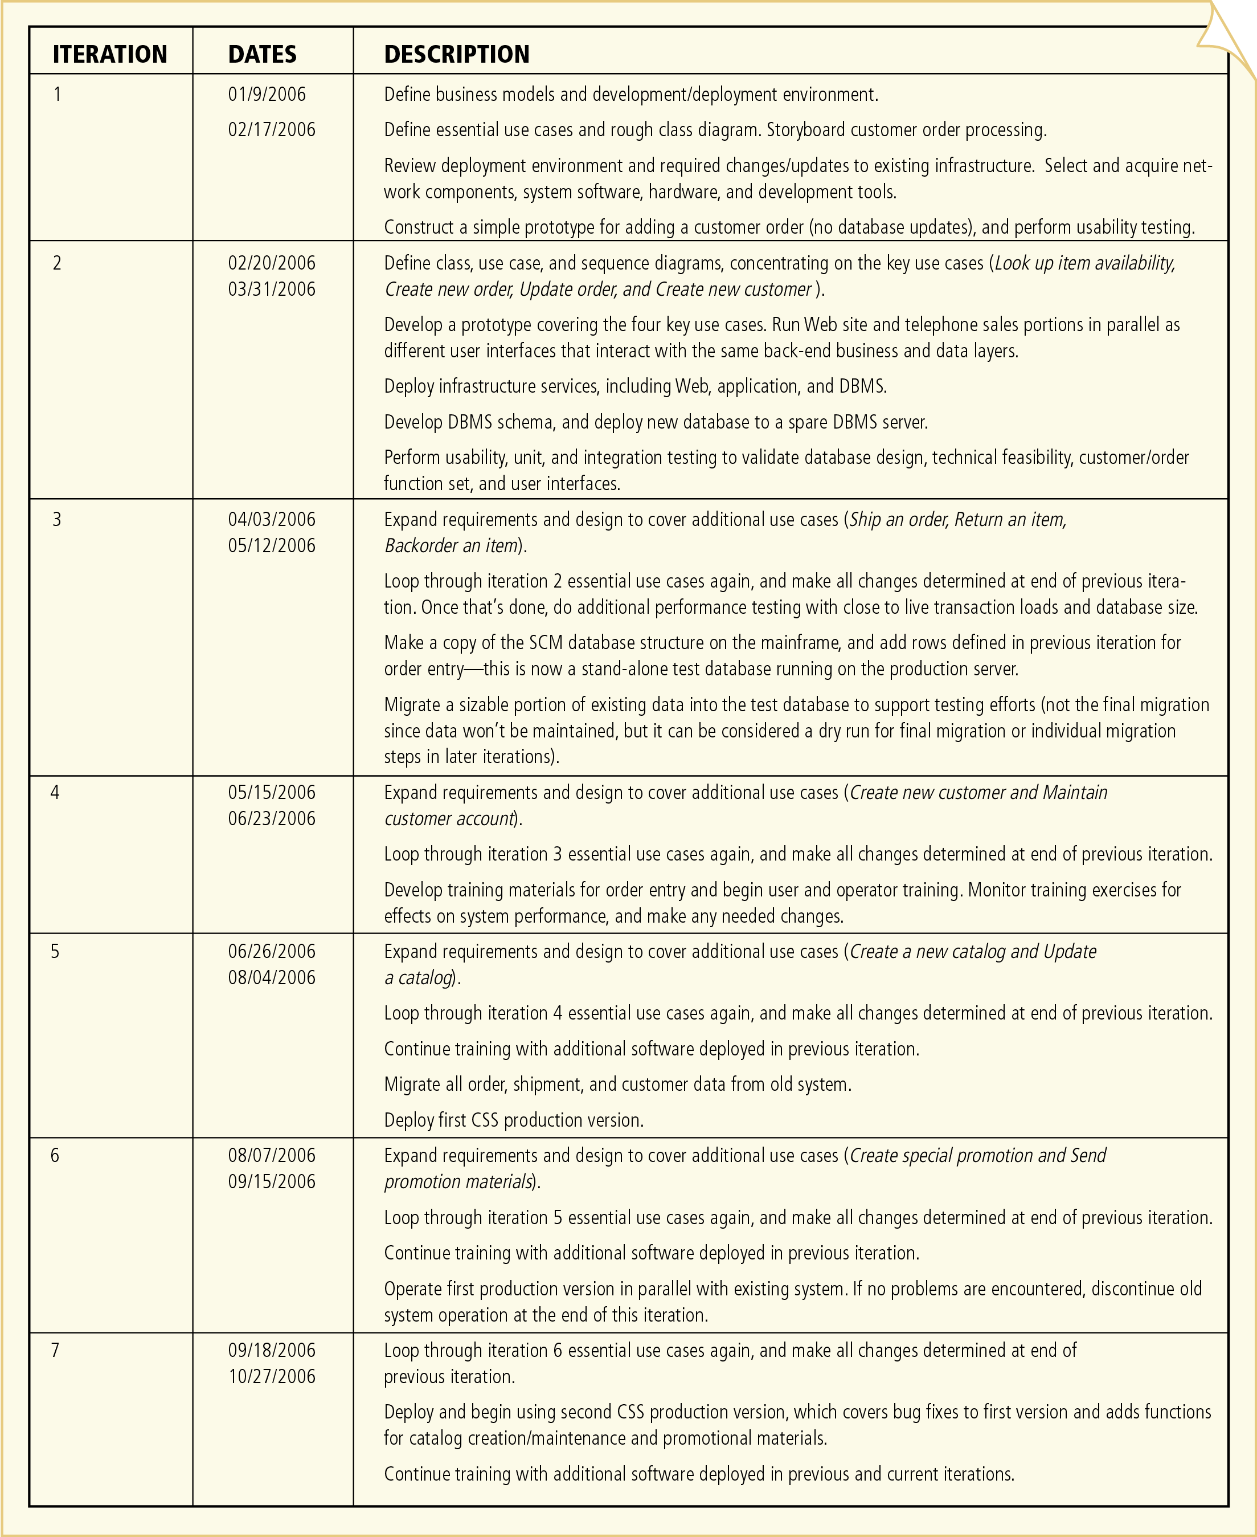
Figure 13-26: RMO CSS iteration plan
Object-Oriented Analysis and Design with the Unified Process

Slide 55
Post-project review
Review should consider:
    Technical methods and standards: how effective, problems and resolution
    Project risks: how handled
    Contractual issues: how resolved
    Customer/supplier relationship issues
    Stakeholder management issues
    Team resourcing issues
    Project performance against plans.
Aim: to learn from experience and improve management of later projects.
Object-Oriented Analysis and Design with the Unified Process

Slide 56
Summary
Implementation is complex, difficult to manage, and risky
Implementation and testing are two of the most interdependent UP disciplines
  A program development plan is a trade-off among available resources, available time, and desire to detect and correct errors prior to system development
Object-Oriented Analysis and Design with the Unified Process

Slide 57
Summary (continued)
Configuration and change management discipline is most applicable to projects that are too large to deploy in a single version
  Use versioning to manage large projects
Deployment activities
  Acquiring hardware and system software
  Packaging and installing components
  Training users
  Converting and initializing data
Object-Oriented Analysis and Design with the Unified Process

